Slide 1

Achieving robust sand textures in powder coatings formulations with PTFE-free additives
September 2025, Derick A Forcha, End-Use Specialist – BYK USA Inc.

Slide 2
Table of Contents
Regulatory Pressures and PFAS concerns
Functional Role of PTFE in Powder Coatings
PTFE-Free Alternatives (race to the finish line)
Formulation Strategies for PTFE-Free Powder Coatings
Case Study – Texture Effects
Durability Evaluation/ Tests
Outlook
Summary and Conclusion

Slide 3
The Transition
Discontinued PFAS Products
The Future – No Use of PTFE
(PFAS-Free) Approach
PTFE SAMPLE 901
PTFE SAMPLE 902
PTFE SAMPLE 903
PTFE SAMPLE 904
PTFE SAMPLE 905
PTFE SAMPLE 906
ORGANOCLAYS TYPE-C
ORGANOCLAYS TYPE-G
UNIQUE WAXES/BLENDS
OTHERS IN R&D
Transition
Texture
effect
Abrasion
resistance
Scratch
resistance

Slide 4
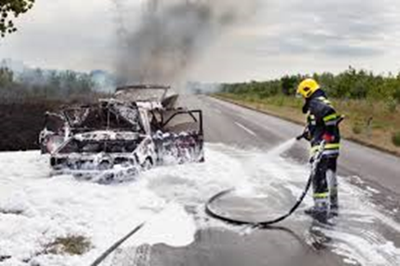
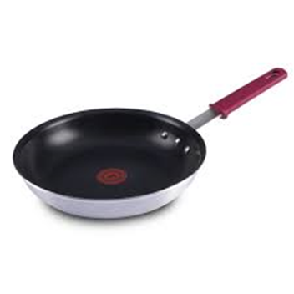
Regulatory Pressures and PFAS Concerns
PFAS – Per- and Polyfluoroalkyl Substances are largely a family of synthetic fluorinated compounds
Extremely stable – Highly resistant to heat, and chemical breakdown
Very Persistent – They don’t degrade easily in the environment
Ubiquitous – widespread presence in drinking water, wildlife and even accumulate in humans over time
PTFE, is a polymerized tetrafluoroethylene & chemically inert
It is in this light, that regulators often target PFAS as a class, meaning inert polymers like PTFE are getting phased out entirely.
THE CONNECTION
The production and processing often involves PFAS based intermediates (PFOA).

Slide 5
California
CURRENTLY PENDING Legislation
Jan. 1, 2027: Prohibits cleaning products, cookware, dental floss, juvenile products, food packaging, or ski wax that contains intentionally added PFAS.
January 1, 2035, prohibit a person from distributing, selling, or offering for sale any other product with intentionally added PFAS, unless covered by another section of the bill.
Jan. 1, 2040: Prohibits refrigerants, solvents, propellants, and clean fire suppressants with intentionally added PFAS, unless the department has determined that the use of PFAS in the product is a currently unavoidable use.
Agency to adopt regulations by Jan.1, 2029

Slide 6

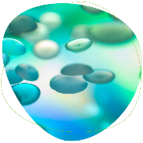
BYK will stops supplying PFAS-containing additives by end of 2025
With years of active research efforts, BYK will be replacing its per- and polyfluoroalkyl additives with more environmentally compatible alternatives.
We have now reached a point that allows us to offer our customers pioneering, sustainable PFAS-free solutions for Powder Coatings additives and beyond.
PFAS-free additives – ORGANOCLAY TYPE-C & ORGANOCLAY TYPE-G, wax & other products

Slide 7
Functional Role of PTFE in Powder Coatings
Slip and Mar Resistance
Anti-scratch Performance
Surface Texture and Gloss Control
Low Friction Properties

Slide 8
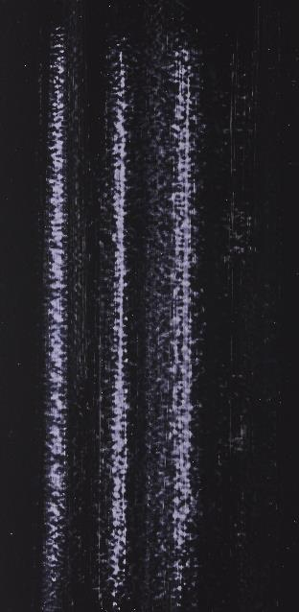
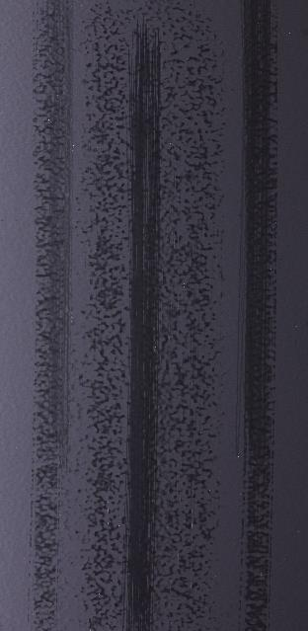

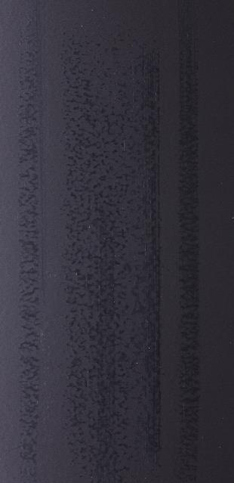

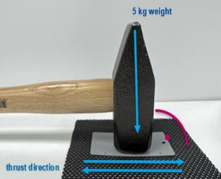
Our current PTFE-free solutions Slip/Scratch Additive and Modified PE/WAX
Martindale gloss retention [%]
Scratch
resistance
Control
2.0 %
PTFE/WAX
0.3 %
Slip/Scratch Add.
2.0 %
Modified PE-WAX
1.0 %
R&D sample
65 %
80 %
70 %
80 %
85 %
Deep scratches
Lubricating film (wax)
Lower gloss
Surface slip + 10 %
Nearly no scratch
High gloss
Surface slip + 40 %
Lubricating film (wax)
Lower gloss
Surface slip + 10 %
Nearly no scratch
High gloss
Surface slip + 40 %

Slide 9
PTFE-Free Alternatives – Race to the Finish
Bio-based polymers – Cellulose derivatives – Not efficient in creating the type of effects that are viable
Wax-Based Additives – Carnuba, PE, PP waxes – Limited in performance and heat stability
Ceramic & Inorganics – Silica, graphite – Not very effective, some addition as high as 10%
Clay-based additives - Shown success in creating ACCEPTABLE sand-textures as well as good test performances

Slide 10

Experience of other PTFE-free solutions in the market Who will be the 1st to offer a good match?

Slide 11
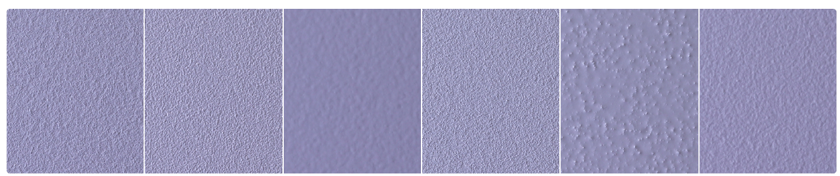
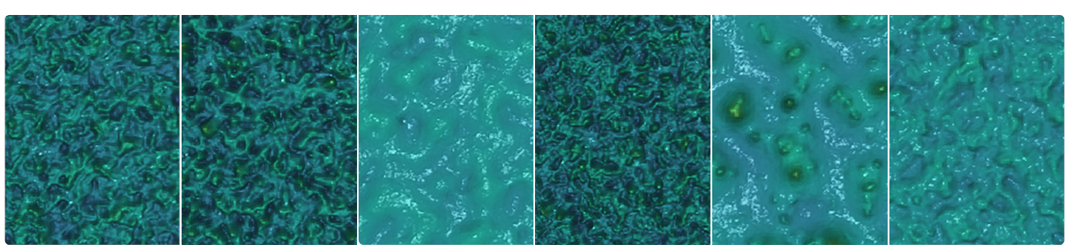
PTFE-free Solutions in the Market
1% PTFE 4% ORGANOCLAY MX 7% COMPTITOR 1 6% COMPETITOR 2 6% COMPETITOR 3 15% COMPETITOR 4

Slide 12
Formulation Strategies for PTFE-Free Powder Coatings
Binder and Resin Considerations
Additive Synergies
Particle Size and Dispersion Optimization
Surface Energy and Application Techniques

Slide 13


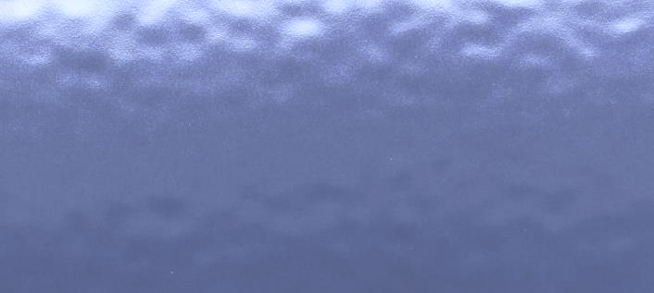



PTFE-Free Replacement in PE-Epoxy Hybrid
Control
0.5 %
PTFE
5.0 %
ORGANOCLAY-G
4.0 %
ORGANOCLAY-C
4.0 % Combination
1:1 TYPE-G/C

Slide 14
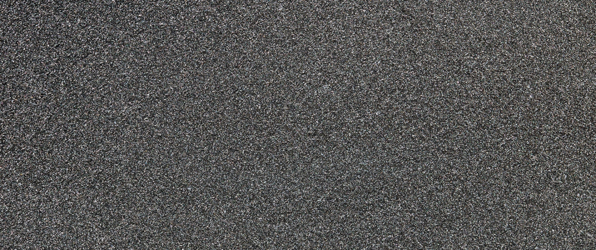
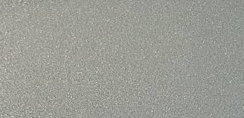
Case Study Part – 1 A complete look into PTFE- free options
Evaluate BYK’s ORGANOCLAY-C and ORGANOCLAY-G type additives for use as PTFE-free alternatives in a super durable powder coatings formulation
Success Criteria: The degree of texture, Flexibility with respect to Mandrel bend, pill flow to qualify the degree of viscosity modification of the system, Gloss measurement as well as other attributes
Premix Mixaco mixer Lab CM 3
Extruder 1x Coperion ZSK 18, 24:1 (Twin screw)
Heating zone 45°C / 45°C / 90°C / 105°C / 105°C / 105°C
Extruder speed 350 rpm
Powder gun Gema OptiFlex2 Funnel

Slide 15
Formulation Case Study I – Texture Effects
Raw materials | Source | DF134 | DF135 | DF136 | DF137 | DF138 | DF139 | DF140 | DF141
Binder/Hardener
Resin (Av 32) |  | 610 | 610 | 610 | 610 | 610 | 610 | 610 | 610
Crosslinker - TGIC |  | 46 | 46 | 46 | 46 | 46 | 46 | 46 | 46
Pigments/ Extender
Titanium dioxide |  | 180 | 180 | 180 | 180 | 180 | 180 | 180 | 180
Pigment Blue 710 |  | 20 | 20 | 20 | 20 | 20 | 20 | 20 | 20
Pigment Black 200 |  | 11 | 11 | 11 | 11 | 11 | 11 | 11 | 11
Barium Sulfate (Cimbar PC) |  | 128 | 128 | 128 | 128 | 128 | 128 | 128 | 128
Additives
Benzoin |  | 3 | 3 | 3 | 3 | 3 | 3 | 3 | 3
BYK-Leveling Additive | BYK-USA | 10
PTFE-Additive | BYK-USA |  | 5
ORGANOCLAY-C (HY) | BYK-USA |  |  | 40
ORGANOCLAY-C (40) | BYK-USA |  |  |  | 40
ORGANOCLAY-G (7305) | BYK-USA |  |  |  |  | 40
ORGANOCLAY-G (1958) | BYK-USA |  |  |  |  |  | 40
CLAY-HY/GA-7305(2%/2%) | BYK-USA |  |  |  |  |  |  | 40
CLAY-HY/GA-7305/HDPE(1%) | BYK-USA |  |  |  |  |  |  |  | 50
 |  | 1008 | 1003 | 1038 | 1038 | 1038 | 1038 | 1038 | 1048
PTFE-FREE

Slide 16
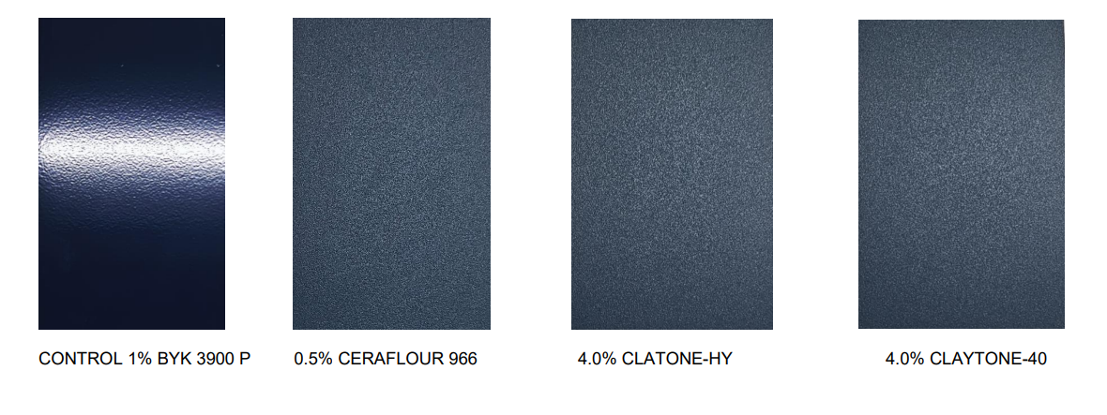
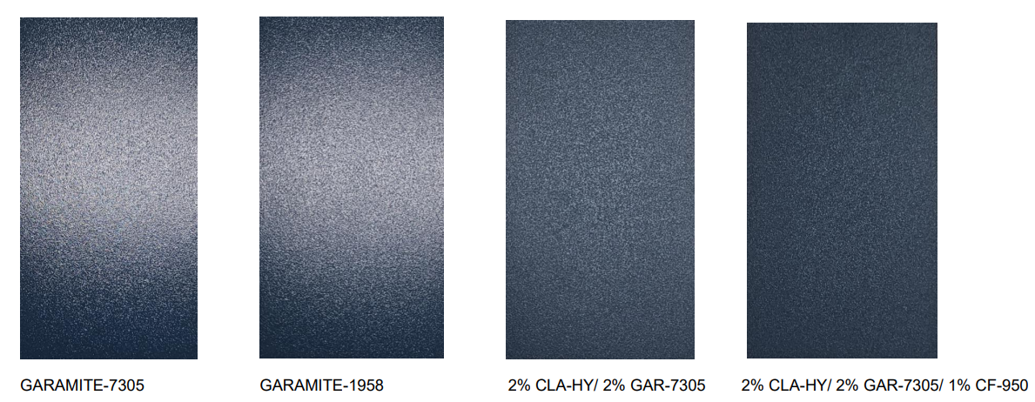
Textures
1% LEVELING 0.5% PTFE 4% ORGANOCLAY-C HY 4% ORGANOCLAY-C 40
4%ORGANOCLAY-G 7305 4%ORGANOCLAY-G 1958 CLAY-HY/GA 7305 (2/2%) CLAY-HY/GA/HDPE (2/2/1%)

Slide 17
Gloss & DFT
No. | Additives | % as delivered | DFT -MILS | 20 | 60 | 85
DF0134 | BYK-Leveling Additive | 1.00% | 2.7-3.1 | 32.4 | 76.2 | 91.5
DF0135 | PTFE-Additive | 0.5% | 2.8-3.1 | 0.2 | 1.9 | 1.5
DF0136 | ORGANOCLAY-C (HY) | 4.00% | 2.7-3.2 | 0.2 | 2 | 2.6
DF0137 | ORGANOCLAY-C (40) | 4.00% | 2.6-3.0 | 0.2 | 2.1 | 2.7
DF0138 | ORGANOCLAY-G (7305) | 4.00% | 2.7-3.2 | 1.1 | 11 | 14.1
DF0139 | ORGANOCLAY-G (1958) | 4.00% | 2.5-3.0 | 0.9 | 9.1 | 11.7
DF0140 | CLAY-HY/GA-7305(2%/2%) | 2%/2%/ | 2.6-3.3 | 0.3 | 2.5 | 2.7
DF0141 | CLAY-HY/GA-7305/HDPE(1%) | 2%/2%/1% | 2.8-3.4 | 0.1 | 1.2 | 1.1

Slide 18
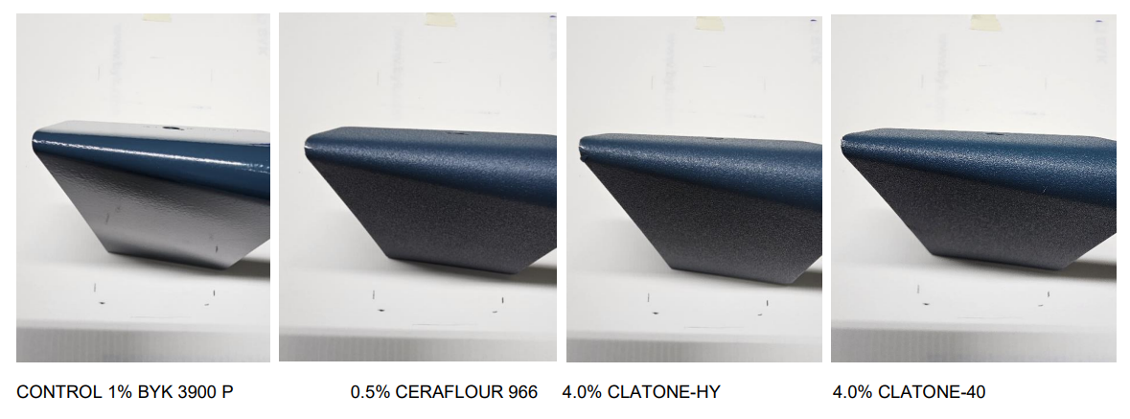
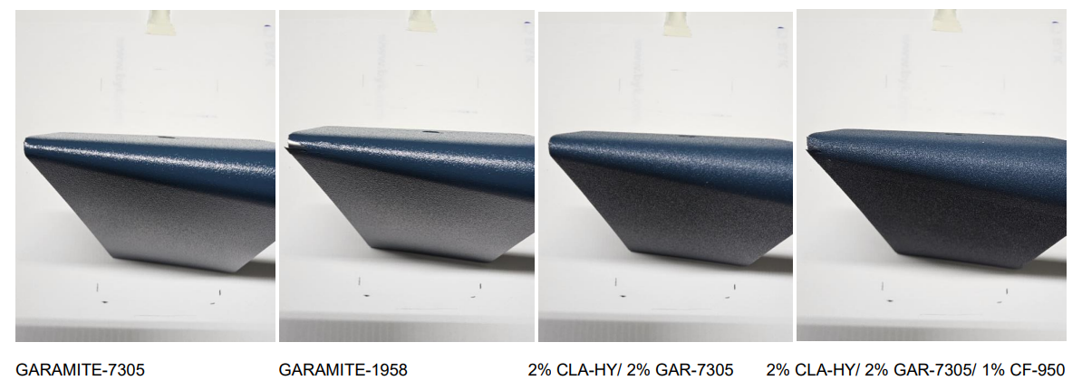
Flexibility – 1/8th Inch conical Mandrel bend test
1% LEVELING 0.5% PTFE 4% ORGANOCLAY-C HY 4% ORGANOCLAY-C 40
4% ORGANOCLAY-G 7305 4%ORGANOCLAY-G 1958 CLAY-HY/GA 7305 (2/2%) CLAY-HY/GA/HDPE (2/2/1%)

Slide 19
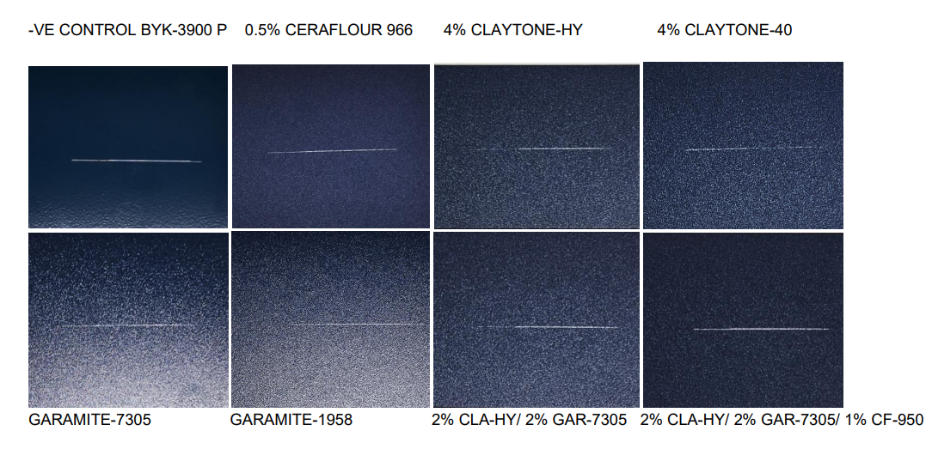
Scratch Mar Evaluation – ERICHSEN Scratch Tester – 14 newtons
1% LEVELING 0.5% PTFE 4% ORGANOCLAY-C HY 4% ORGANOCLAY-C 40
4%ORGANOCLAY-G 7305 4%ORGANOCLAY-G 1958 CLAY-HY/GA 7305 (2/2%) CLAY-HY/GA/HDPE (2/2/1%)

Slide 20
Case Study 1 on PTFE-Fee Additives – Pellet flow test
Inch

Slide 21
Case Study Summary on Texture Effects
Through careful evaluation, we contend that clay-based additives can, in fact, give similar textures.
Formulators must recognize:
The potential/inherent challenges especially with super-durable formulations
How to best optimized the binder ratios with different clay-based additives to give the desired textures
The need for synergistic fillers to lower gloss or resin systems are important
The threshold for an exact PTFE Vs PTFE-free performance must be carefully evaluated and calibrated
We therefore conclude that a more enhanced approach to PTFE-free formulation is possible with the use of clay-based additives

Slide 22
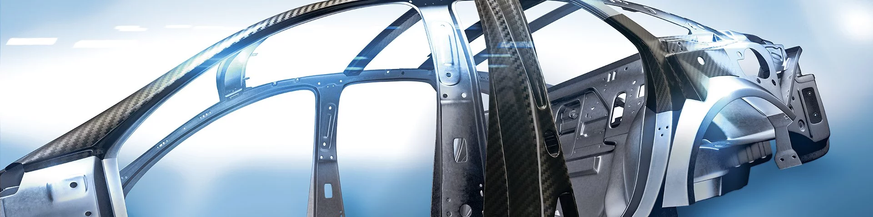
Durability Considerations:
Xenon
Salt Spray

Slide 23
Salt Spray PTFE vs PTFE-free additives in PRIMID Powder Coatings
Raw Material | Source | DF142 | DF143 | DF144 | DF145 | DF146 | DF147 | DF148 | DF149 | DF150 | DF151
Binder/Hardener
Resin (Av 32) |  | 618 | 618 | 618 | 618 | 618 | 618 | 618 | 618 | 618 | 618
PRIMID Crosslinker |  | 33 | 33 | 33 | 33 | 33 | 33 | 33 | 33 | 33 | 33
Pigments/Extender
Titanium dioxide |  | 195 | 195 | 195 | 195 | 195 | 195 | 195 | 195 | 195 | 195
FW-200 Black |  | 10 | 10 | 10 | 10 | 10 | 10 | 10 | 10 | 10 | 10
Barium Sulfate (Cimbar PC) |  | 128 | 128 | 128 | 128 | 128 | 128 | 128 | 128 | 128 | 128
Additives
Benzoin |  | 6 | 6 | 6 | 6 | 6 | 6 | 6 | 6 | 6 | 6
BYK-Leveling Additive | BYK-USA | 10
PTFE-Additive | BYK-USA |  | 5
ORGANOCLAY-C (HY) | BYK-USA |  |  | 25
ORGANOCLAY-C (40) | BYK-USA |  |  |  | 25
ORGANOCLAY-G (7305) | BYK-USA |  |  |  |  | 25
ORGANOCLAY-G (1958) | BYK-USA |  |  |  |  |  | 25
CLAY-HY/GA-7305(2%/2%) | BYK-USA |  |  |  |  |  |  | 40
CLAY-HY/GA-7305/HDPE(1%) | BYK-USA |  |  |  |  |  |  |  | 50
ORGANOCLAY G - (1210) | BYK-USA |  |  |  |  |  |  |  |  | 25
ORGANOCLAY C- (AF) | BYK-USA |  |  |  |  |  |  |  |  |  | 25
TOTAL |  | 1000 | 995 | 1015 | 1015 | 1015 | 1015 | 1030 | 1040 | 1015 | 1015
PTFE-FREE

Slide 24
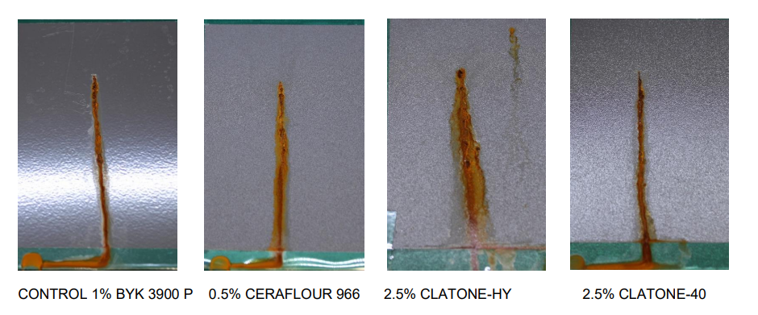
Salt Spray B-117 – 376 hours
POSITIVE CONTROL
1% LEVELING 0.5% PTFE 2.5% ORGANOCLAY-C HY 2.5% ORGANOCLAY-C 40

Slide 25
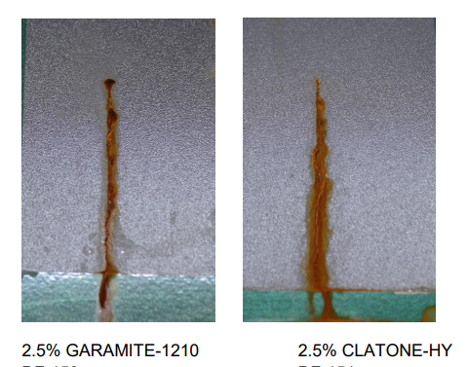
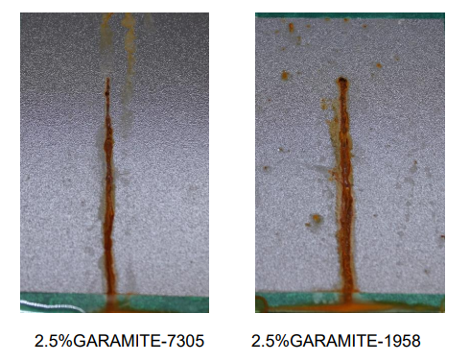
Salt Spray B-117 – 376 hours
2.5%ORGANOCLAY-G 7305 2.5%ORGANOCLAY-G 1958 2.5%ORGANOCLAY G 1210 2.5% ORGANOCLAY-C HY
The organoclays showed similar performance to the positive control

Slide 26
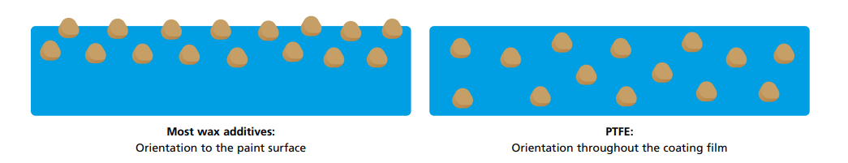
Case Study II - Abrasion and Scratch Evaluation
ADDITIVES | FUNCTION | PTFE -STATUS
PTFE WAX/BLEND | PTFE/PE Wax/Surface protection - scratch/ abrasion | CONTAINS PTFE
Polymer-base | Surface protection - Scratch and Slip properties | PTFE-free
PE Wax 1050 | PE Wax for improved scratch & Abrasion resistance | PTFE-free
PE Wax 1051 | PE Wax for improved scratch & Abrasion resistance | PTFE-free

Slide 27
Formulation
Raw materials | Source | DF0110 | DF0111 | DF0112 | DF0113 | DF0114
RESIN |  | 570 | 570 | 570 | 570 | 570
PRIMID CROSSLINKER |  | 30 | 30 | 30 | 30 | 30
Benzoin |  | 8 | 8 | 8 | 8 | 8
leveling Additive | BYK-USA | 10 | 10 | 10 | 10 | 10
Pigment BLACK |  | 15 | 15 | 15 | 15 | 15
PTFE WAX/BLEND | BYK-USA |  | 5
Polymer-base slip/scratch add. | BYK-USA |  |  | 10
PE WAX-1050 | BYK-USA |  |  |  | 10
PE WAX- 1051 | BYK-USA |  |  |  |  | 10
Filler - 1 |  | 150 | 150 | 150 | 150 | 150
Filler -2 |  | 217 | 217 | 217 | 217 | 217
Total |  | 1000 | 1005 | 1010 | 1010 | 1010
Structure/PS consideration

Slide 28
Coefficient of friction data - ASTM D 1894 & ASTM C 1028
COF Trials | CONTROL | PTFE WAX/BLEND | Polymer-Base Slip/scratch Aid | PE WAX-1050 | PE WAX-1051
1 | 0.196 | 0.200 | 0.144 | 0.216 | 0.211
2 | 0.199 | 0.204 | 0.140 | 0.216 | 0.211
3 | 0.199 | 0.207 | 0.145 | 0.214 | 0.212
Average/mean (units) | 0.198 | 0.204 | 0.143 | 0.215 | 0.211
No. | Additives | 20º | 60º | 85º | Observation
DF0110 | Control | 13.3 | 56.9 | 81.2
DF0111 | PTFE WAX/BLEND | 15.9 | 60.0 | 89.0 | 0.5%, slightly waxy
DF0112 | Polymer-base slip/scratch add. | 14.1 | 57.4 | 86.1
DF0113 | PE WAX-1050 | 13.8 | 57.6 | 87.6
DF0114 | PE WAX- 1051 | 13.8 | 57.5 | 87.4

Slide 29
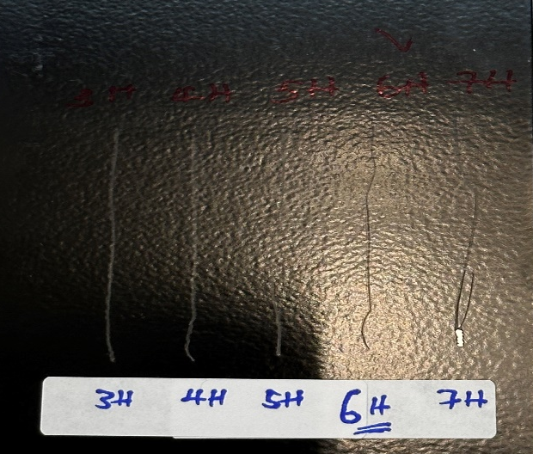
Scratch Performance – ASTM D 3363 / Gloss 60º - ASTM D 523
No. | Additives | Pencil Hardness Scratch | GLOSS (60)
DF0110 | Control | 3H | 56.9
DF0111 | PTFE WAX/BLEND | 5H | 60.0
DF0112 | Polymer-base slip/scratch add. | 6H | 57.4
DF0113 | PE WAX-1050 | 5H | 57.6
DF0114 | PE WAX- 1051 | 4H | 57.5
Note: Pencil hardness was the pencil that did not gouge the film, BYK”s polymer-based slip/scratch additive was the best slip additive as well as scratch/ mar performance

Slide 30
Summary & Conclusion Case Study II
BYK’s polymer-based slip/scratch additive showed superior performance in terms of having the lowest coefficient of friction 0.143
Pencil scratch test, of 6H
BYK’s polymer-based slip/scratch additive showed superior performance for scratch and slip properties in a Polyester TGIC-free system.

Slide 31



Summary of PTFE-free solutions in Powder Coatings
Scratch
resistance
Abrasion
resistance
Texture
effect
ORGANOCLAY-G/C
Polymer-based Slip add.
PE-WAX 1051
ORGANOCLAY-C (HY) mainly in hybrid
ORGANOCLAY-G (1958) mainly in HAA
Synergy combinations
Dosage range = 3.0 % - 6.0 %
R&D Efforts ongoing
Surface protection good slip properties
Dosage level = 0.2 % - 1.0 %
Blooming Free
Surface protection by lubrication
R&D Efforts ongoing
Improvement of > 20 % - 35 %
R&D Efforts ongoing
Improvements of > 50 %
Application tests ongoing
HDPE-WAX 924
PE-WAX 1051

Slide 32

Chat with me at the BYK Booth!
Derick Forcha
Derick.Forcha@altana.com

Slide 33

Chat with us at the BYK booth!
Smriti Arora
Smriti.Arora@altana.com
Friday, September 5, 8:30-9:00am
Achieving Robust Sand Textures in Powder Coatings Formulations with PTFE-Free Additives
Derick Forcha
Derick.Forcha@altana.com

Slide 34
Thank you for your attention.

Slide 35
Disclaimer
ANTI-TERRA®, AQUACER®, AQUAMAT®, AQUATIX®, BENTOLITE®, BYK®, BYK-AQUAGEL®, BYK®-DYNWET®, BYK‑MAX®, BYK®‑SILCLEAN®, BYKANOL®, BYKCARE®, BYKETOL®, BYKJET®, BYKONITE®, BYKOPLAST®, BYKUMEN®, CARBOBYK®, CERACOL®, CERAFAK®, CERAFLOUR®, CERAMAT®, CERATIX®, CLAYTONE®, CLOISITE®, DISPERBYK®, DISPERPLAST®, FULACOLOR®, FULCAT®, GARAMITE®, GELWHITE®, HORDAMER®, LACTIMON®, LAPONITE®, NANOBYK®, OPTIBENT®, OPTIGEL®, PURABYK®, RECYCLOBYK®, RHEOBYK®, SCONA®, SILBYK®, TIXOGEL® and VISCOBYK® are registered trademarks of the BYK group. The information contained herein is based on our current knowledge and experience. No warranties, guarantees and/or assurances of any kind, either express or implied, including warranties of merchantability or fitness for a particular purpose, are made regarding any products mentioned herein and data or information set forth, or that such products, data or information may be used without infringing intellectual property rights of third parties. Any information about suitability, use or application of the products is non-binding and does not constitute a commitment regarding the products’ properties, use or application. Contractual terms and conditions, in particular agreed product specifications, always take precedence. We recommend that you test our products in preliminary trials to determine their suitability for your intended purpose prior to use. We reserve the right to make any changes and to update the information herein without notice.

