Slide 1
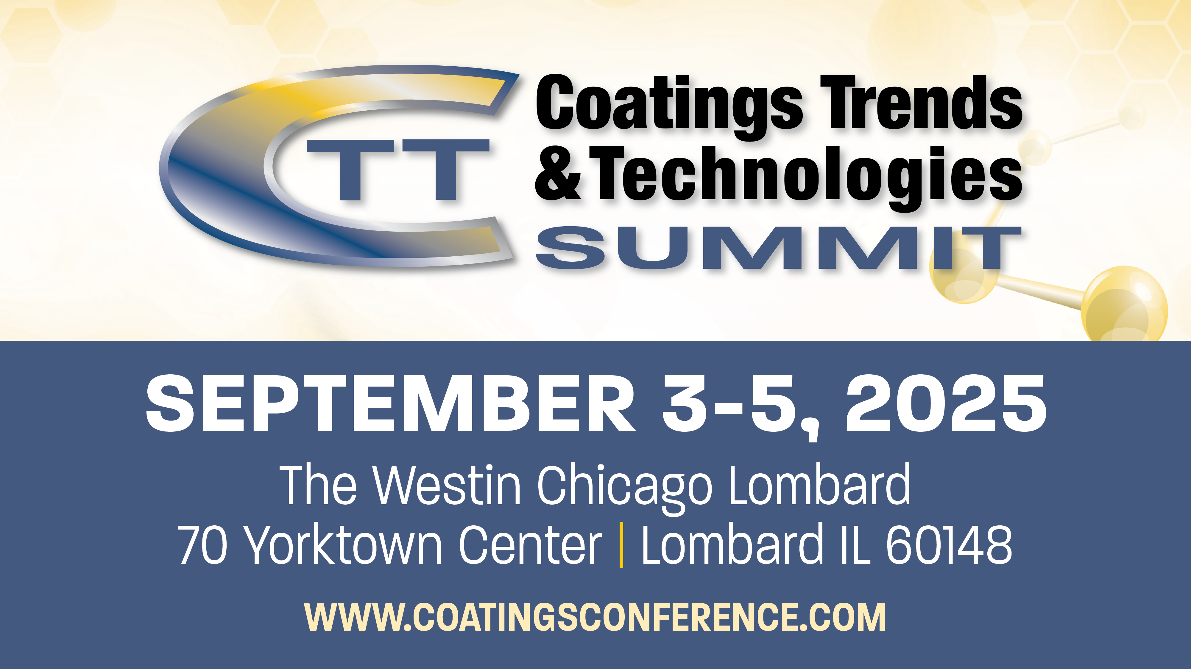

Slide 2
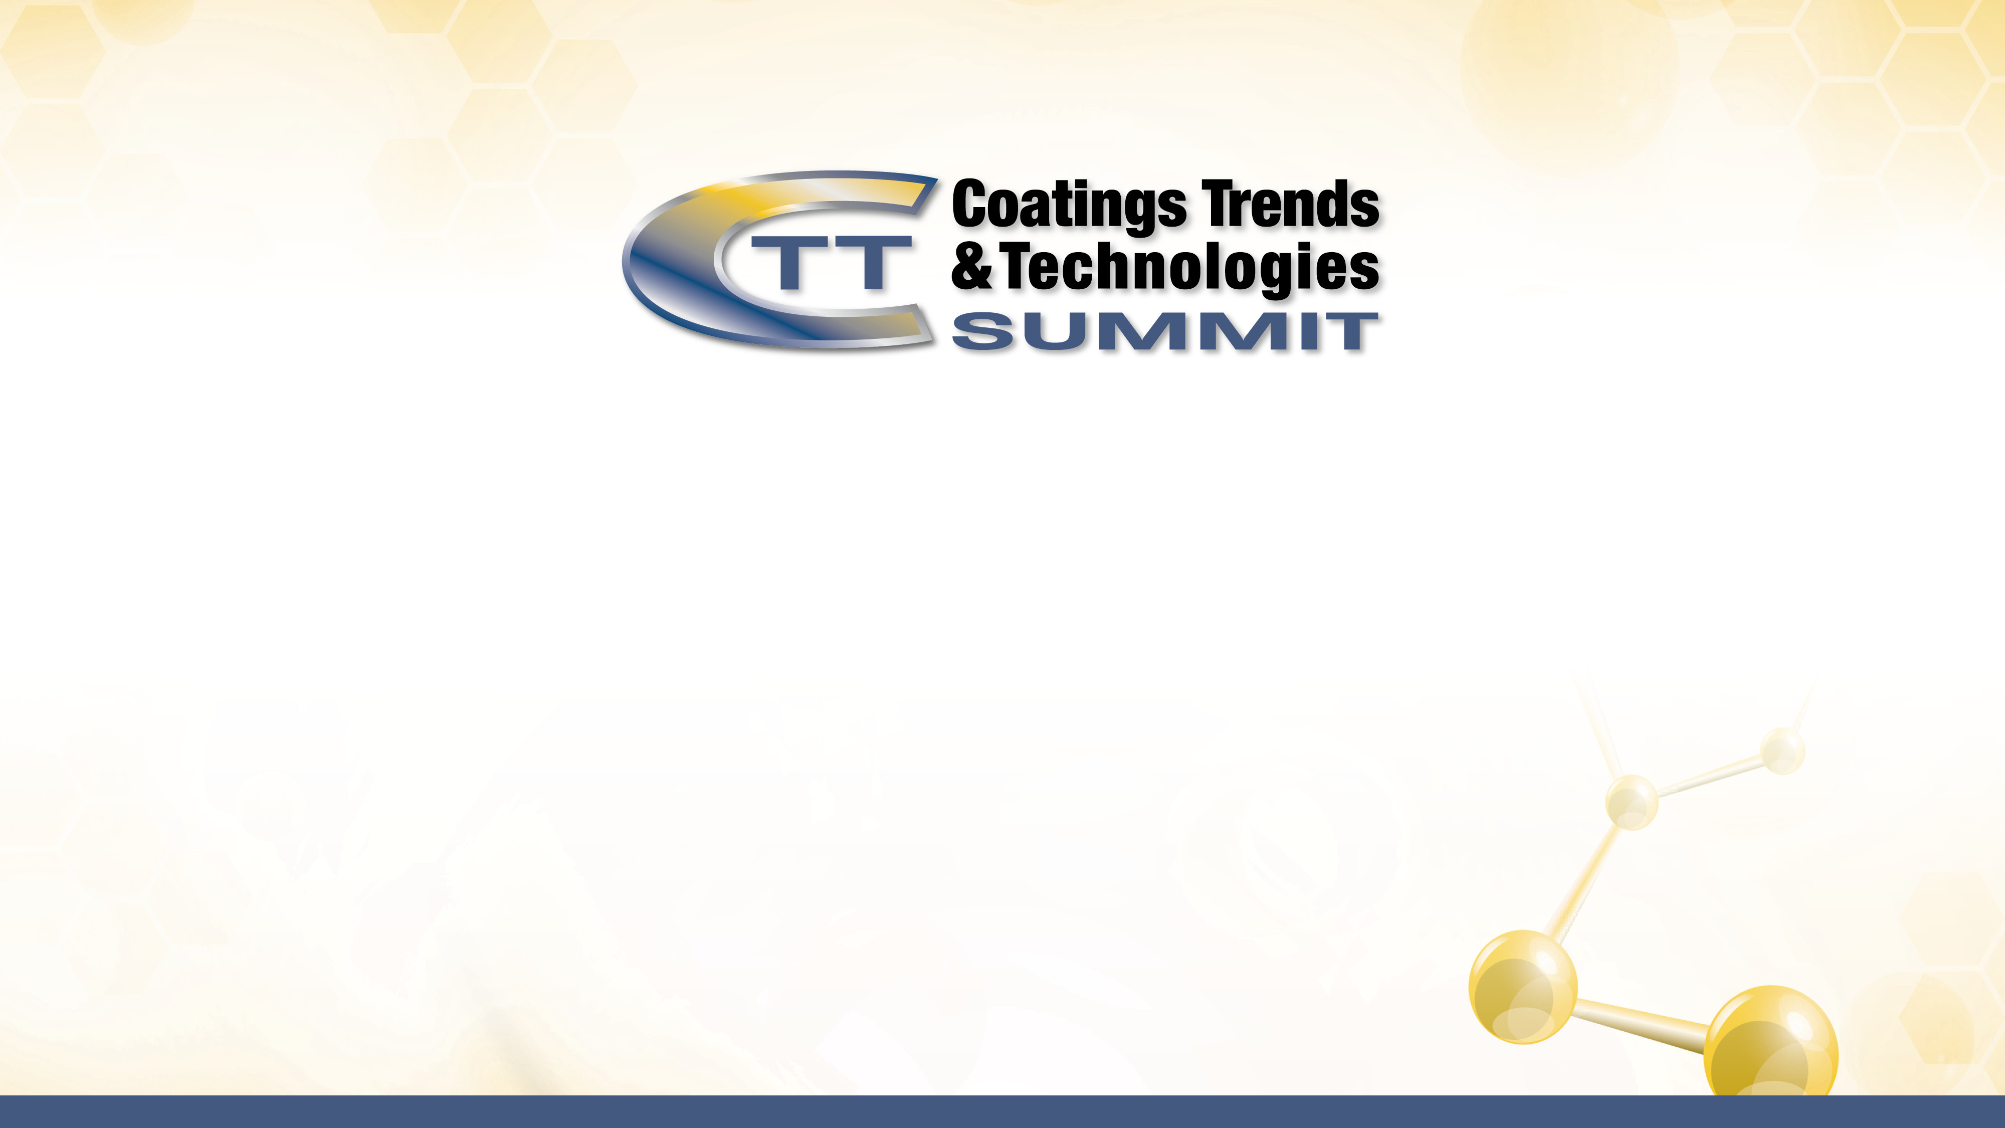

Slide 3

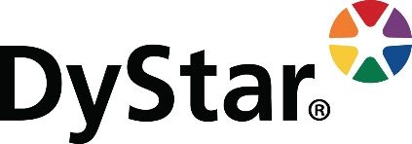
Harnessing Generative AI for Defoamer Innovation
DyStar’s Integration of ChatGPT in Coatings Additive Development
Bryan Haltom
Business Manager - Americas
Performance Chemicals

Slide 4

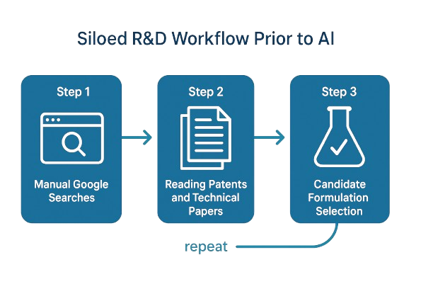
Today’s topic - Rapid Best-in-class Organically Modified Silicone Defoamer Development
Challenge (Before AI)
Goal: match/beat best-in-class organically modified silicone defoamer performance
12+ months of effort ended with no formulation meeting spec.

Slide 5
AI-Powered Breakthrough
R&D Time-to-Solution
Created a custom GPT with a proprietary knowledge base →
DyStar R&D Product Development Assistant
Our chemist used the custom GPT to create an entirely new polymer backbone.
Also used AI tool for raw material procurement, DOE, formulation, and analysis.
Lead Candidate
in 4 mo’s
Dead-end
In 12 mo’s
65%
vs.
0%
Reduction in
R&D time
No reduction in
R&D time

Slide 6
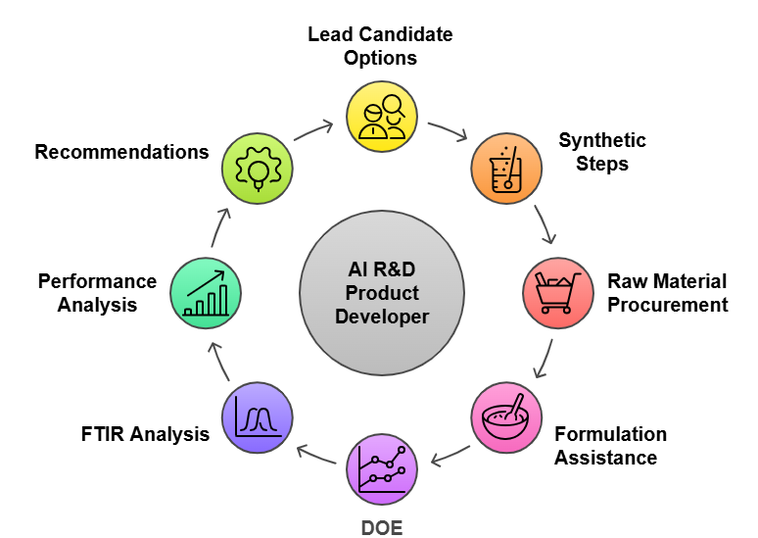
AI-Powered Integrated Workflow

Slide 7
Analyzing Challenges in Waterborne Coatings
Compatibility
R&D Approaches
Chemical interactions
Empirical methods
Formulation stability
Iterative processes
Persistent foam in
waterborne coatings
Application methods
Regulatory compliance
Defoamer
effectiveness
Sustainability demands
Defoaming Efficiency
Market Drivers

Slide 8
The Role of AI in Coatings Additives
1
AI extracts valuable
insights from vast
datasets.
Data Mining
AI formulates
innovative research
hypotheses rapidly.
Hypothesis
Generation
2
AI optimizes
experimental
designs for better
outcomes.
Experimental
Design
Enhanced Research
Efficiency
3
AI accelerates
chemical
simulations and
predictions.
Computational
Chemistry
4
AI automates rapid
screening of
chemical
compounds.
High-Throughput
Screening
5

Slide 9
Research Workflow with ChatGPT
AI Proposes Molecular
Groupings
AI Suggests Dosage Strategies
AI Suggests Carrier Systems

Slide 10
DyStar’s Vision - AI as a research co-pilot
Accelerated
Innovation
Streamlined, efficient
defoamer outcomes
Additive
Development
Workflow
ChatGPT Integration
AI-powered research
assistance
Traditional defoamer
formulation process

Slide 11
Case Example – Organically modified siloxane structure
Externally-sourced polymers either didn’t work or too expensive
Compatibility
Synthesis
Capability
Defoaming Performance
Cost

Slide 12
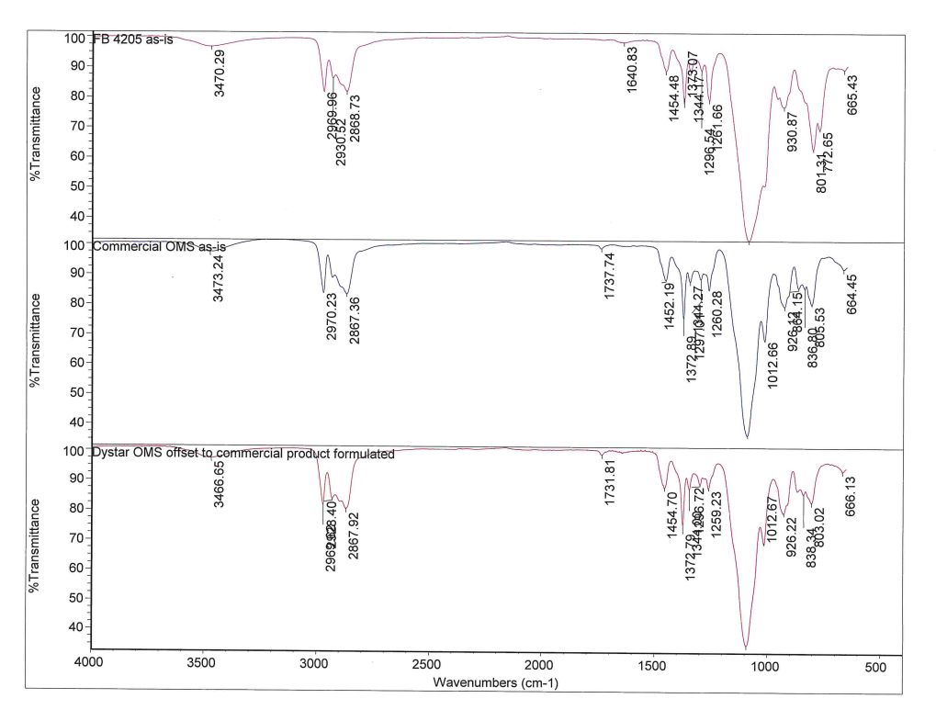
Spectral Comparison of Defoamers
1st Gen Attempt (Pre-AI)
AI helped discern different stretches and peaks
Best-in-class defoamers used as benchmarks
Lead candidate vs benchmark now much closer
Benchmark
Lead Candidate

Slide 13
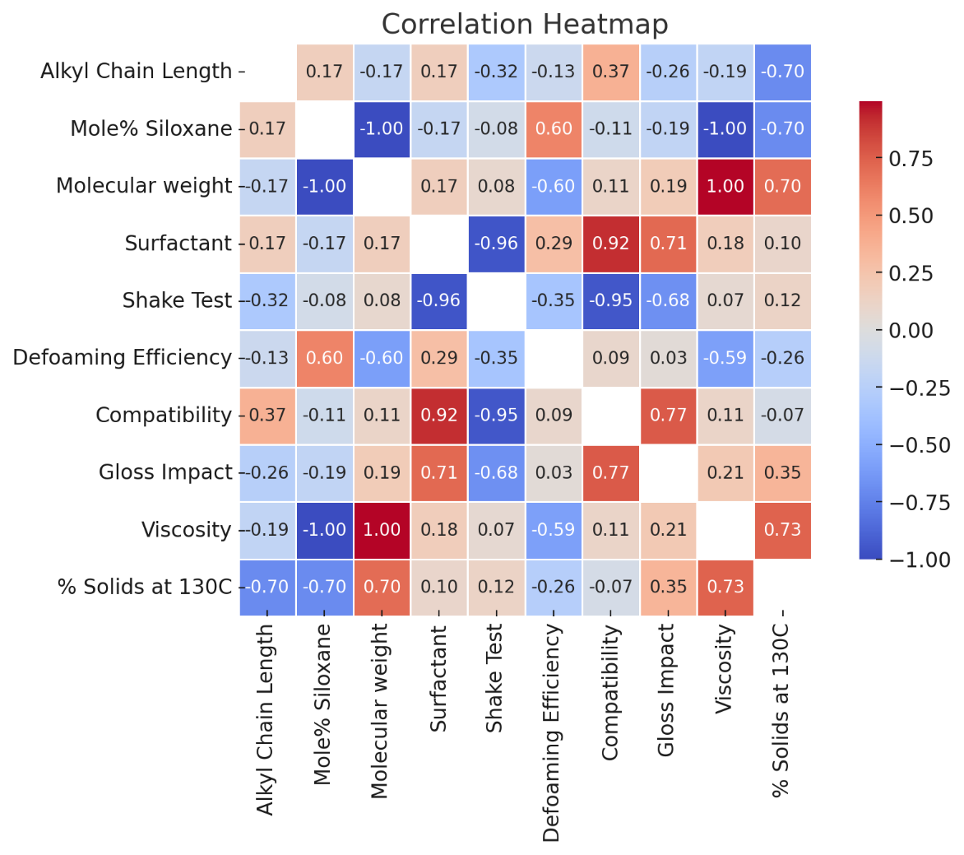
Statistical Analysis Example
Suggestions from AI:
  Heat map
  Response Surface Methodology (RSM)
  Central Composite Design (CCD)
  Box-Behnken Design (BBD) matrix
Look for non-obvious correlations to determine direction

Slide 14
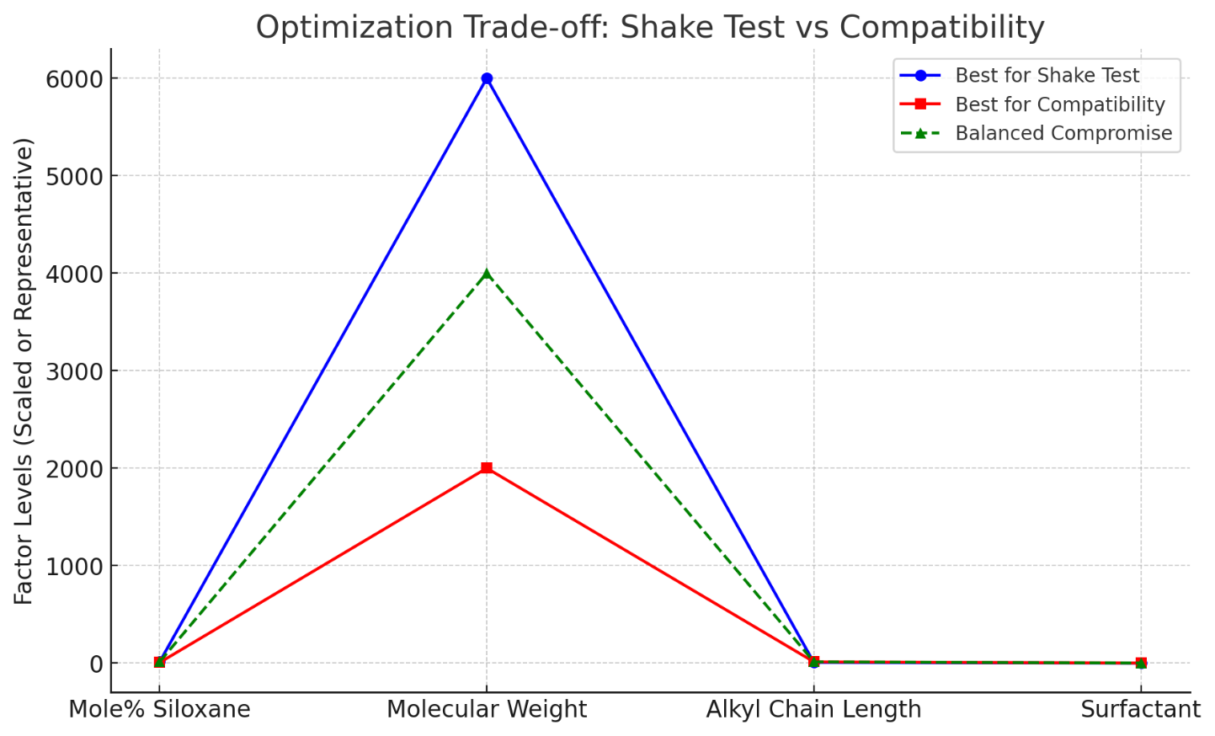
Defoaming/Compatibility Optimization
AI recommendation: vary siloxane %, molecular weight, alkyl chain length, and surfactant types
Lab validation: improved gloss retention, stable viscosity profile

Slide 15
Comparison of DOE Results
Lead candidates identified following 4 X 8 DOE varying siloxane, alkyl, and surfactants

Slide 16
Advanced Applications Data
Leading candidates continue to be evaluated
Excellent performance against internal and external benchmarks
Polymer application into EPA for commercialization

Slide 17
Benefits Realized
Inefficient
Research
Faster
Hypothesis-to-Lab
Reduced
Screening Tests
Better
Regulatory
Alignment
Efficient
Research
Slow, redundant,
misaligned research
Streamline the
evaluation process
Ensure
straightforward
compliance
Fast, streamlined,
compliant research
Accelerate concept to
application

Slide 18
Challenges & Limitations
Pros
Cons
Enhanced accuracy
Data quality issues
Improved efficiency
Training set bias
Data-driven
insights
Need for validation

Slide 19
Future Directions
Customer
Feedback
Integration
Sustainability
Focus
AI Model
Development
Incorporating
customer insights
into AI models
Shifting towards
eco-friendly
formulations
Creating specialized
AI models for
defoamer design

Slide 20
Conclusion – AI is an Amplifier of Expertise
AI Integration
Incorporating AI
tools to augment
abilities
Innovation
Drive
Collaboration
Invitation
Leading
advancements in AI-
enabled solutions
What additives projects do you have that DyStar can accelerate?

Slide 21


Bryan Haltom
Performance Chemicals Business Manager
Industrial Colorants & Additives
haltom.bryan@dystar.com
+1 980 257 2288
Steve Crast
Research & Development Manager
Performance Chemicals
crast.steven@dystar.com
+1 704 561 3073
Wayne Juda
Sr. Research & Development Chemist
Performance Chemicals
juda.wayne@dystar.com
+1 704 561 2789

