Slide 1
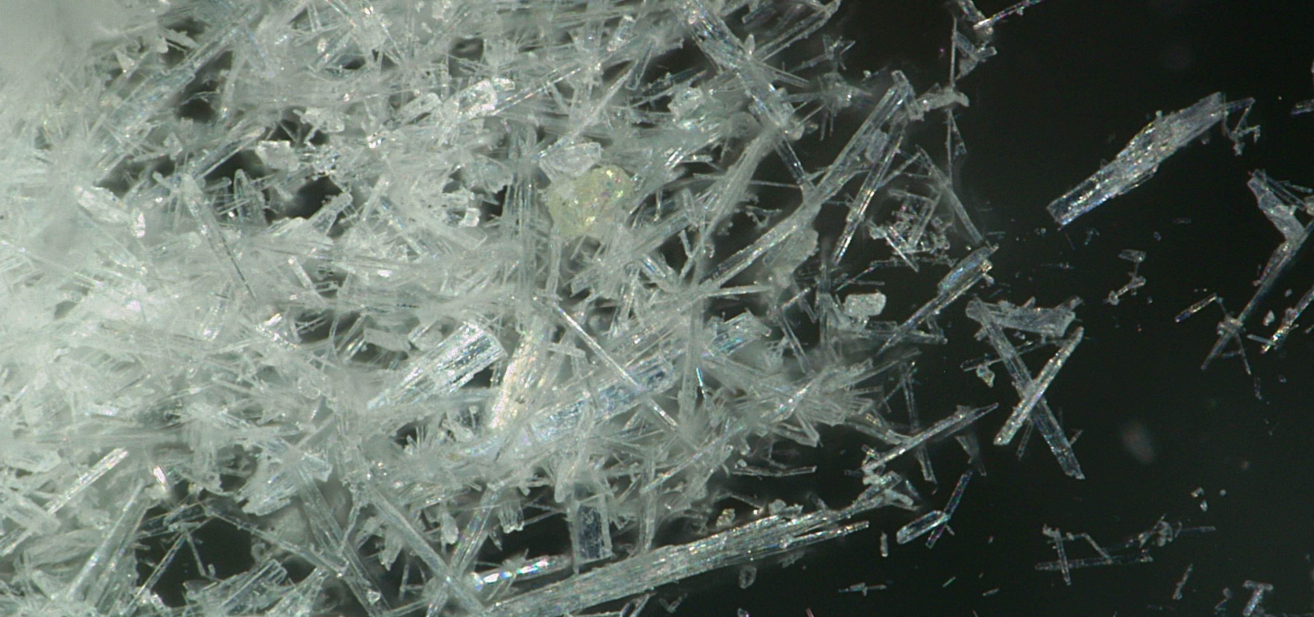
Use of Wollastonite as functional filler in coatings
© Lehmann&Voss&Co. KG

Slide 2



Lehmann&Voss&Co. LEHVOSS Group
Excellence in Detail.
© Lehmann&Voss&Co. KG

Slide 3
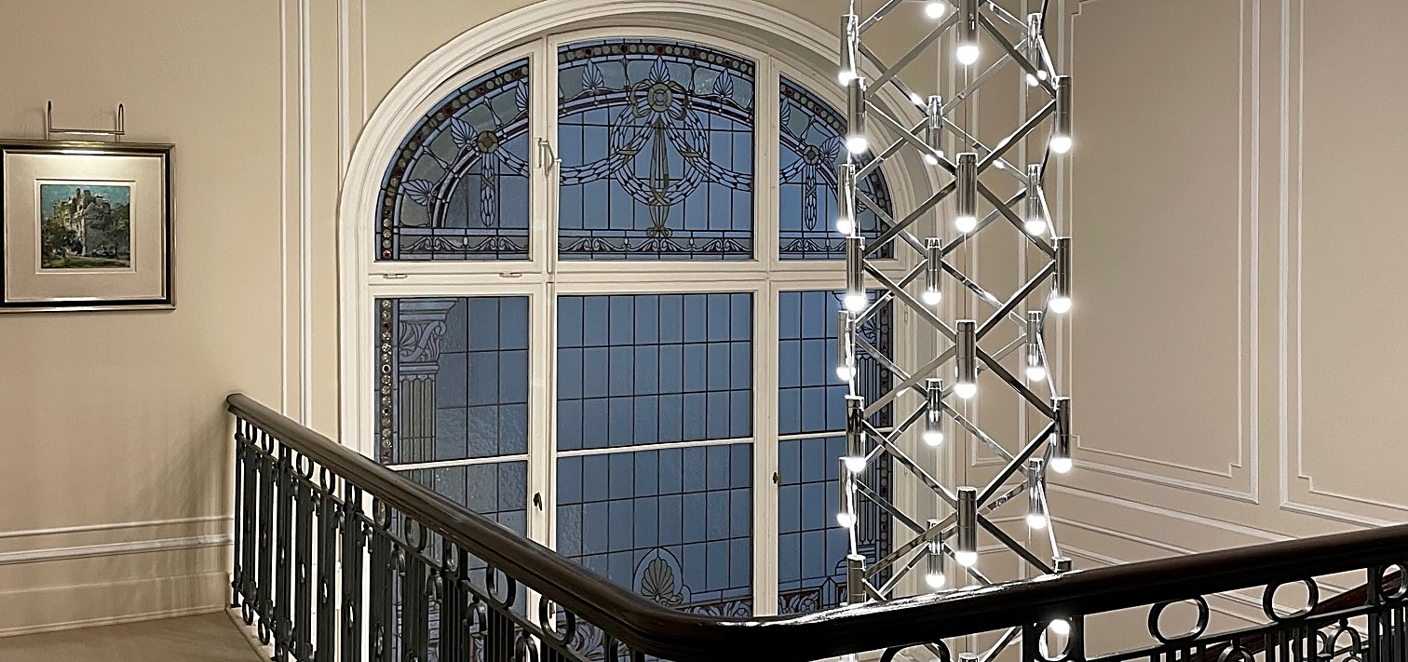

4th generation family-owned business
Lehmann&Voss&Co. KG
LEHVOSS Group (HQ)
Founded in 1894 by Alfred Lehmann and Helmuth Voss in Hamburg
Own production since 1903
Application technology laboratory since 1907
Diverse and specialized sales and marketing organization
Leading expert for chemical and mineral specialties
© Lehmann&Voss&Co. KG

Slide 4















Business areas and product ranges
Plastics and Rubber
High-performance compounds
Technical compounds
Masterbatches and additives
Composite materials
Raw materials for rubber
Special Chemicals and
Industrial Minerals
Magnesium
compounds
Rare earth / zirconium compounds
Raw materials for paints and coatings, inks, construction chemicals, adhesives and sealants
Additives for metal working fluids, lubricants and functional fluids
Products for filtration and separation
Life Sciences
Raw materials for
personal care
Nutrition minerals
Nutraceuticals
Pharmaceutical
raw materials
Products for filtration and separation
© Lehmann&Voss&Co. KG

Slide 5
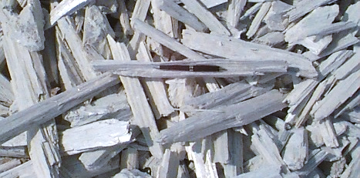
Use of Wollastonite as functional filler in coatings
© Lehmann&Voss&Co. KG

Slide 6
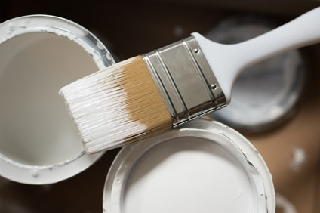
Summary
What’s in a coating?
Focus on fillers
Functional fillers
What is Wollastonite?
Sample formulations
Benefits of Wollastonite in coatings
© Lehmann&Voss&Co. KG

Slide 7
What‘s in a coating?
Coatings are materials applied to surfaces to form solid, continuous, adherent films or barriers, that enhance, beautify, or protect them
The main components of a coating are
Binders
Pigments
Extenders or Fillers
Cost reduction
Enhancement of mechanical performance
Gloss and texture control
Rheology control
Improvement of chemical and thermal performance
Functional effects
Solvents
Miscellaneous Additives
© Lehmann&Voss&Co. KG

Slide 8
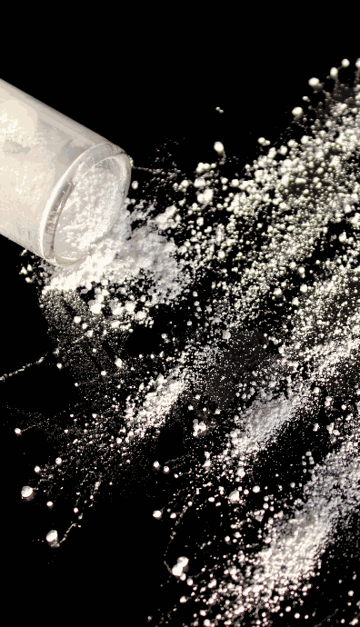
What’s in a coating? Functional fillers
Functional fillers are ingredients used
not just to reduce cost or bulk up the formulation, but
to enhance specific properties or performance of the coating
Unlike inert or extender fillers, functional fillers
play active roles in improving physical, chemical, or mechanical characteristics
Type | Main purpose | Impact on properties
Inert (extender) | Reduce cost, add bulk, adjust gloss | Minimal active role
Functional | Improve performance and durability | Active contribution to functionality
© Lehmann&Voss&Co. KG

Slide 9
Functional fillers
Function | Description | Examples
Barrier | Control permeability to moisture, gases, or chemicals | Talc, mica, clay, wollastonite
Corrosion | Improve corrosion protection | Zinc phosphate, calcium zinc molybdate, wollastonite
Flame | Reduce flammability or improve substrate protection | Aluminum trihydrate, magnesium hydroxide
UV | Protect substrate and coating from UV | Titanium dioxide, zinc oxide
Electrical | Make coatings conductive or dissipative | Carbon black, graphite, carbon nanotubes
Thermal | Improve heat dissipation or insulation | Boron nitride, aluminum oxide, silica, hollow microspheres
Slip/Traction | Provide texture or grip to surfaces | Silica sand, corundum
Scratch & abrasion | Increase hardness and improve wear resistance | Silica, alumina, solid microspheres
Rheology | Control flow, sag, and settling during storage and application | Fumed silica, organoclays
© Lehmann&Voss&Co. KG

Slide 10
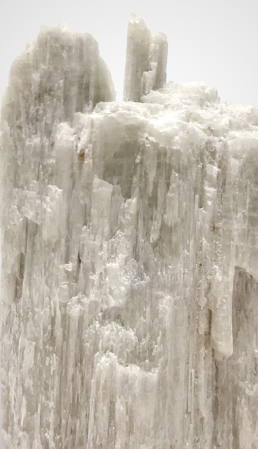
What is Wollastonite?
A naturally occurring calcium metasilicate with formula CaSiO₃
Commonly used as a functional filler in paints and coatings, plastics, ceramics, and construction materials due to its unique combination of:
chemical stability
alkaline potential
acicular (needle-like) shape, and
performance-enhancing properties
Used in
industrial coatings (e.g., anti-corrosion primers)
automotive OEM and refinish paints
powder coatings
architectural coatings
© Lehmann&Voss&Co. KG

Slide 11
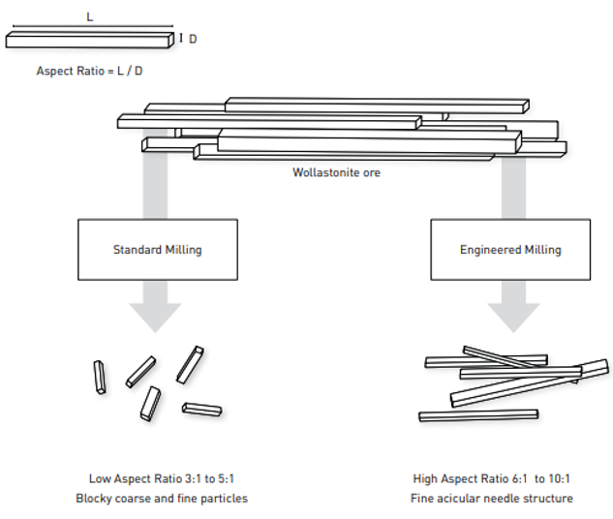
What is Wollastonite? Milling and aspect ratio
© Lehmann&Voss&Co. KG

Slide 12
What is Wollastonite? Milling and aspect ratio (L/D)
Low L/D
High L/D
© Lehmann&Voss&Co. KG

Slide 13
What is Wollastonite? Why is aspect ratio important?
Low aspect ratio: Short, stubby particles
easier to disperse and less costly, however lesser benefits in reinforcement and barrier properties
High aspect ratio: Long, thin, needle-shaped particles
more effective in reinforcement, however costlier and more difficult to process
the higher the aspect ratio, the more Wollastonite behaves like a functional reinforcing agent
it improves mechanical strength, barrier properties, and dimensional stability — all critical in high-performance coatings
Aspect ratio is but one factor: particle size is also important, especially in coatings
© Lehmann&Voss&Co. KG

Slide 14
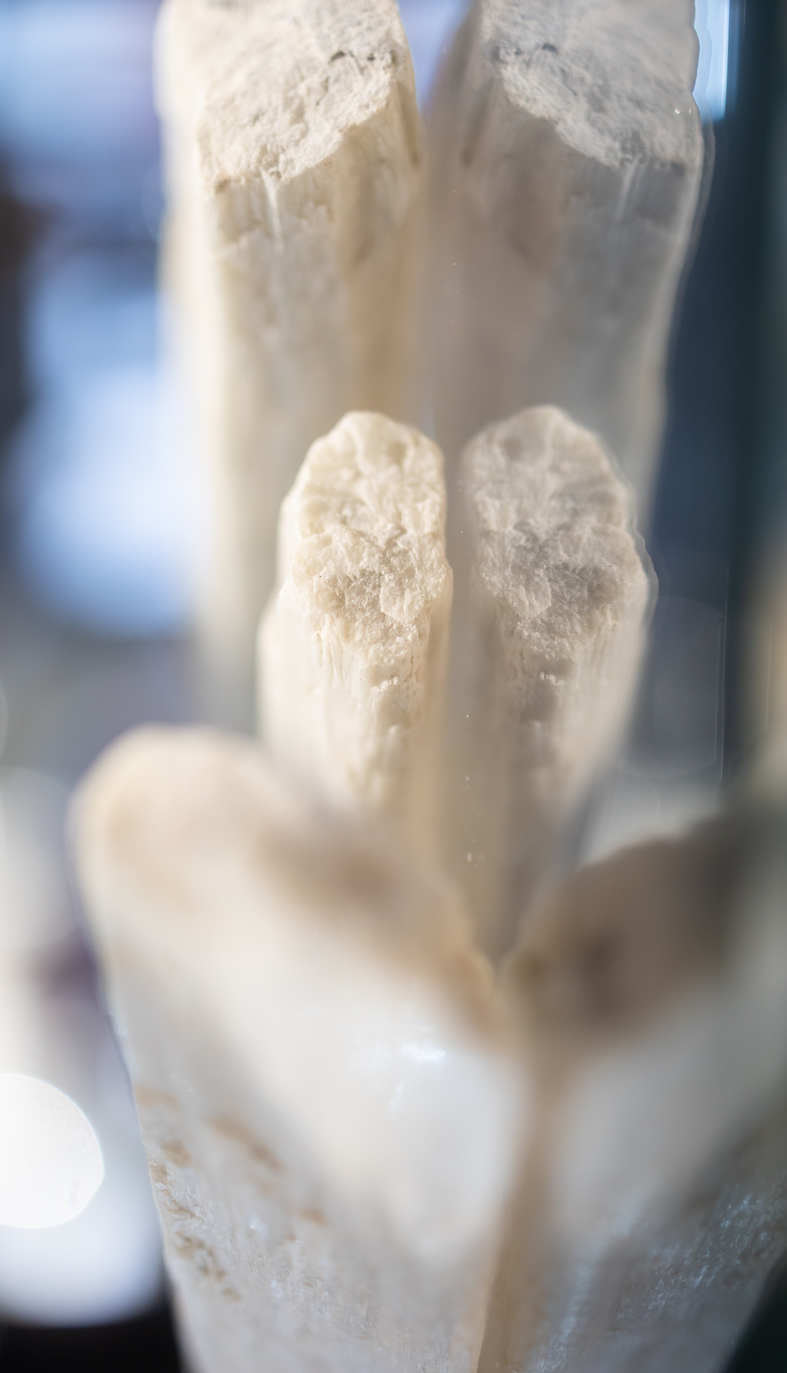
Wollastonite in coatings General-purpose waterborne acrylic paint
Grind phase |  |  |  | Letdown phase
Ingredient | wt. % | Alternative, wt. % |  | Ingredient | wt. %
Water | 15.0 |  |  | Acrylic binder | 35.0
Dispersant | 0.3 |  |  | Coalescent | 1.0
Defoamer | 0.2 |  |  | HASE or HEUR thickener | 1.0
Wetting agent | 0.2 |  |  | Water | 4.8
pH adjuster | 0.2 |  |  | Biocide | 0.1
TiO₂ | 15.0 |  |  | Defoamer | 0.2
Wollastonite (4-6 μm) | 20.0
CaCO₃ | 7.0 | 22.0
Talc |  | 5.0
© Lehmann&Voss&Co. KG

Slide 15
Wollastonite in coatings General-purpose waterborne acrylic paint
Characteristic |  | Wollastonite | CaCO₃/Talc
PVC | % | 45 | 45
Solids | vol. % | 40 | 38
60° gloss | % | < 5 | < 6
Opacity | D2805 | > 0.96 | > 0.94
Scrub resistance | D2486, cycles | > 800 | 450
Burnish resistance |  | Very good | Fair
Adhesion | D3359 | 5B | 4B
Water resistance |  | No blistering or discoloration | Slight discoloration
Touch-up |  | Good | Fair
Sag resistance |  | Very good | Fair
© Lehmann&Voss&Co. KG

Slide 16
Wollastonite in coatings General-purpose waterborne acrylic paint
+80% higher scrub resistance due to reinforcement from acicular particles
Improved hardness and anti-burnish properties — key for premium matte wall paints
Better film cohesion and crack resistance, especially in higher PVC systems
Slightly better water and alkali resistance
The use of Wollastonite may require adjustments of dispersant, thickener, and/or water to match the required viscosity profile
© Lehmann&Voss&Co. KG

Slide 17
Wollastonite in coatings Solventborne alkyd (primer or general-purpose topcoat)
Binder |  |  | Pigment / filler package
Ingredient | wt. % |  | Ingredient | wt. %
Long oil alkyd, 60 % solids | 40.0 |  | TiO₂ | 15.0
Mineral spirits | 20.0 |  | Wollastonite 6 µm | 14.0
Xylene | 4.5 |  | CaCO₃ | 5.0
Cobalt octoate | 0.1
Calcium/Zirconium drier | 0.2
Anti-skinning | 0.2
Wetting/dispersing | 0.3
Defoamer | 0.2
Bentonite | 0.5
© Lehmann&Voss&Co. KG

Slide 18
Wollastonite in coatings Solventborne alkyd (primer or general-purpose topcoat)
Characteristic
PVC | % | 45
VOC | g/l | 400
Viscosity | KU | 90
60° gloss | % | < 10
Dry time (touch) | h | 4 – 6
Recoat time | h | 16 - 24
Scrub resistance | D2486, cycles | > 1000
Adhesion | D3359 | 5B
Impact resistance | In.lb | > 100
Salt-spray resistance | B117, h | > 250
© Lehmann&Voss&Co. KG

Slide 19
Wollastonite in coatings Solventborne alkyd (primer or general-purpose topcoat)
Improves abrasion resistance and hardness
Acicular structure improves stress distribution in film
Improves dimensional stability, reduces cracking
Enhances the corrosion protection of active anticorrosive pigments, increasing service time of the coating
© Lehmann&Voss&Co. KG

Slide 20
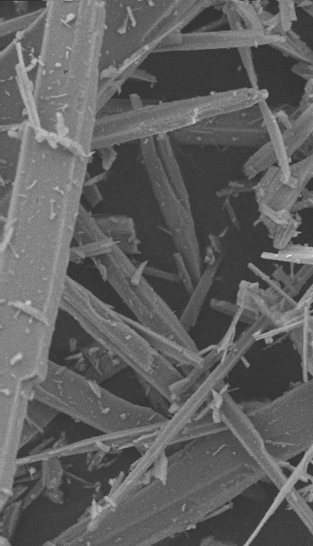
Wollastonite in coatings Solventborne alkyd anticorrosive primer
Binder |  |  | Pigment / filler package
Ingredient | wt. % |  | Ingredient | wt. %
Medium oil alkyd, 60 % solids | 40.0 |  | Zn₃(PO₄)₂ | 12.0
Aromatic solvent | 8.0 |  | Wollastonite 6 μm | 12.0
Xylene | 10.0 |  | Fe₃O₄ (micaceous) | 5.0
Cobalt octoate | 0.3 |  | BaSO₄ | 5.0
Calcium/Zirconium drier | 0.3 |  | Talc | 6.0
Anti-skinning | 0.2
Wetting/dispersing | 0.4
Defoamer | 0.2
Bentonite | 0.6
© Lehmann&Voss&Co. KG

Slide 21
Wollastonite in coatings Solventborne alkyd anticorrosive primer
Characteristic
VOC | g/l | 430
Sag resistance |  | Good at 75 – 100 μm DFT
Adhesion | D3359 | 5B
Impact resistance | In.lb | > 100
Salt-spray resistance | B117, h | > 500
Wollastonite reduces microcracking in thick films
Wollastonite enhances corrosion resistance
© Lehmann&Voss&Co. KG

Slide 22
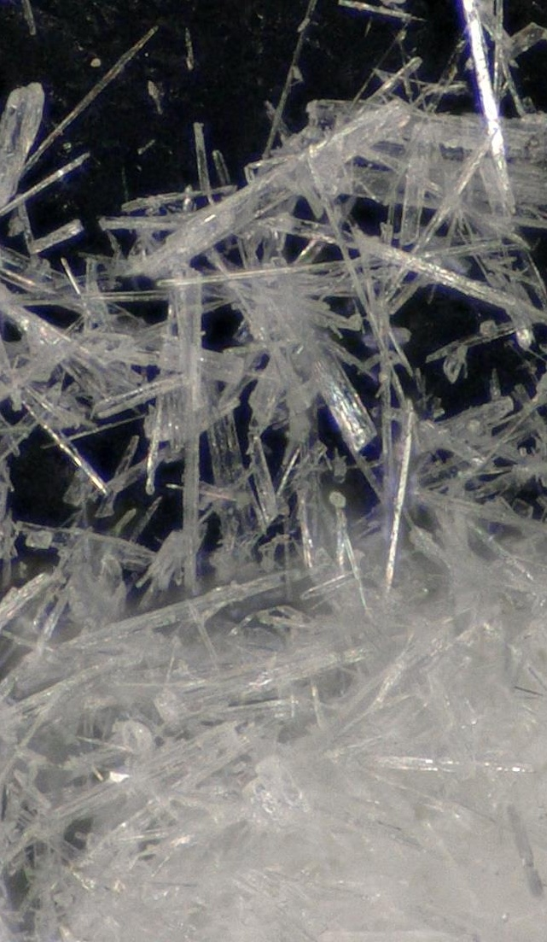
Wollastonite in coatings Solventborne alkyd wood coating
Binder |  |  | Pigment / filler package
Ingredient | wt. % |  | Ingredient | wt. %
Long oil alkyd, 60 % solids | 40.0 |  | TiO₂ | 14.0
White spirits | 25.0 |  | Wollastonite 4-6 μm | 18.0
Cobalt octoate | 0.2 |  | Talc | 2.0
Calcium/Zirconium drier | 0.2
Anti-skinning | 0.2
Wetting/dispersing | 0.2
Defoamer | 0.2
© Lehmann&Voss&Co. KG

Slide 23
Wollastonite in coatings Solventborne alkyd wood coating
Characteristic
60° gloss | % | 30
Sandability | 24 hours | Excellent
Block resistance |  | Good
Scratch resistance |  | Very good
Dry time (touch) | h | 6 – 8
Recoat time | h | 24
Wollastonite
enhances surface hardness
reduces burnishing
improves sheen control for satin finishes
© Lehmann&Voss&Co. KG

Slide 24
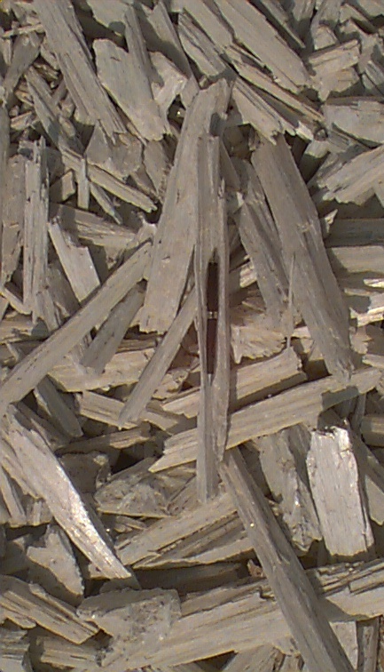
Wollastonite in coatings 60/40 hybrid powder coating
Binder
Ingredient | wt. % |  | Processing
Epoxy resin | 36.0 |  | Premix | High-speed mixing (3 min at ~1500 rpm)
Polyester resin | 24.0 |  | Extrusion | Dual-zone twin-screw extruder @ 90–120 °C
Benzoin | 0.5 |  | Grinding | Air-classifier mill to 30–40 µm average
Flow modifier | 1.0 |  | Sieving | <125 µm sieve (standard)
TiO₂ | 20.0
Wollastonite | 13.5
BaSO₄ | 5.0
© Lehmann&Voss&Co. KG

Slide 25
Wollastonite in coatings 60/40 hybrid powder coating
Characteristic
60° gloss | % | 30
Adhesion | D3359 | 5B
Direct impact | in-lb. | > 160
Pencil hardness |  | 3H
Mandrel bend | mm | Pass 5
Taber abrasion | mg loss, 1000 cycles | < 80
Salt-spray resistance | B117, 168 h | No corrosion, no blistering
Humidity resistance | D2247, 500 h | No blistering
Stain resistance | D1308 | Very good
© Lehmann&Voss&Co. KG

Slide 26
Wollastonite in coatings 60/40 hybrid powder coating
Wollastonite
enhances scratch and impact resistance
helps matting without waxes
is excellent for high-temperature applications
improves mechanical properties without embrittlement
improves chemical resistance
© Lehmann&Voss&Co. KG

Slide 27
Wollastonite in coatings Low-bake polyester-HAA powder coating
Binder
Ingredient | wt. % |  | Processing
Low-bake polyester resin | 43.0 |  | Premix | High-speed mixing (3 min at ~1500 rpm)
Hydroxyalkylamide | 2.5 |  | Extrusion | Dual-zone twin-screw extruder @ 90–100 °C
Benzoin | 0.5 |  | Grinding | Air-classifier mill to 30–35 µm average
Flow modifier | 1.0 |  | Sieving | <125 µm sieve (standard)
TiO₂ | 30.0
Wollastonite | 18.0
BaSO₄ | 5.0
© Lehmann&Voss&Co. KG

Slide 28
Wollastonite in coatings 60/40 hybrid powder coating
Characteristic
60° gloss | % | 40
Adhesion | D3359 | 5B
Blocking resistance |  | Very good
Pencil hardness |  | 2H
Wollastonite
increases scratch resistance
helps matting without affecting flow defects
© Lehmann&Voss&Co. KG

Slide 29
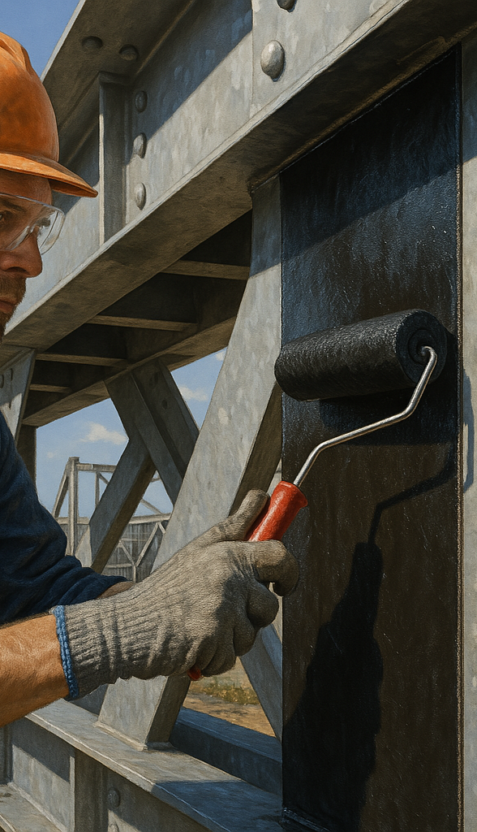
Benefits of Wollastonite in coatings
Wollastonite is ideal for a broad range of systems, waterborne , solventborne, and 100-%:
Architectural, marine and protective, wind turbine topcoats, automotive, aerospace and pipe coatings
As corrosion protection enhancer in general
enhances the anti-corrosive performance
the alkaline potential of Wollastonite helps neutralize acidic corrosive agents and/or prevent the formation of corrosive byproducts
Increased scratch resistance
© Lehmann&Voss&Co. KG

Slide 30
Benefits of Wollastonite in coatings
Structure agent in powder coatings
similarly to bulk plastics and composites, Wollastonite in powder coatings increases tensile properties, in addition to chemical and anticorrosive properties
Erosion-resistant coatings for wind turbine blades
Shop primers (Wollastonite contributes to the formation of slag during welding)
Because of its low oil absorption, Wollastonite can be used in low-viscosity systems, resulting in lower VOC levels
Wollastonite may also be surface-treated with silanes
this improves compatibility with organic materials, leading to even better mechanical properties increased resistance of coatings
© Lehmann&Voss&Co. KG

Slide 31
Thank you!
LEHVOSS North America, Inc.
Business Unit Coating Solutions
Marcelo Herszenhaut
Mobile: +1 678 294 2972
e-mail: marcelo.herszenhaut@lehvoss.com
© Lehmann&Voss&Co. KG

Slide 32
What is Wollastonite? Characteristics
Characteristic
Appearance | Powder to needle-shaped granulate, non-toxic and free of dangerous substances
Chemical composition | CaSiO₃ / (Ca₃(Si₃O₉) (calcium metasilicate)
Hardness | 4.5 – 5.0 Mohs
Melting point | 1,540 °C (2,800 °F) Crystal structure and physical properties stable up to 1,120°C (2,050 °F)
pH | 9.9 in a 10-% slurry in water
Particle size | 10 to 1,250 μm
Density | 2.8 – 2.9 g/cm³ (23.4 to 24.2 lb./gal)
Chemical resistance | Inert, however sensitive to strong acids
© Lehmann&Voss&Co. KG

Slide 33
What is Wollastonite? A quick comparison
Characteristic | Wollastonite | Talc | Mica
Formula | CaSiO₃ | Mg₃Si₄O₁₀(OH)₂ | KAl₂(AlSi₃O₁₀)(OH)₂
Particle shape | Acicular (needle) | Plately (lamellar) | Platey (lamellar)
Reinforcement | Excellent (due to shape) | Low (soft mineral) | Moderate
Barrier properties | Good | Very good | Very good
Abrasion Resistance | Moderate to High | Low (soft mineral) | Moderate
Thermal Stability | High (up to 1400°C) | Moderate (~800°C) | High (~1000°C)
Chemical Resistance | Good | Good | Good
Gloss Control | Moderate | Strong | Acceptable
Anti-sag / Rheology | Very good | Limited effect | Limited effect
Weathering / UV Stability | Good | Good | Excellent
Cost | Moderate | Economic | High
© Lehmann&Voss&Co. KG

Slide 34
What is Wollastonite? A quick comparison
Filler | Best used in
Wollastonite | High-performance coatings needing strength, abrasion resistance, thermal stability, corrosion resistance
Talc | Architectural paints, primers, low-cost systems needing matting
Mica | Exterior coatings needing weather resistance, barrier properties, anti-corrosion
© Lehmann&Voss&Co. KG

